Slide 1
Data Warehouse Analytics
C9-Week-3
Describe the purpose of analytics and business intelligence (BI) tools.
Identify several well-known analytics and business intelligence tools.
Describe Cognos Analytics.
Register to use the Cognos Analytics platform.
Navigate around the Cognos Analytics interface.
Build simple dashboards using Cognos Analytics.
Create interactive and advanced dashboards using Cognos Analytics.
Discuss the advanced features of IBM Cognos Analytics.
Perform advanced Cognos Analytics actions such as creating calculations and leveraging navigation paths.
Describe the steps required to access a database or data warehouse from Cognos Analytics.
Create an interactive dashboard in Cognos Analytics by using data in a data warehouse.
Add visualizations to a Cognos Analytics dashboard.

Slide 2
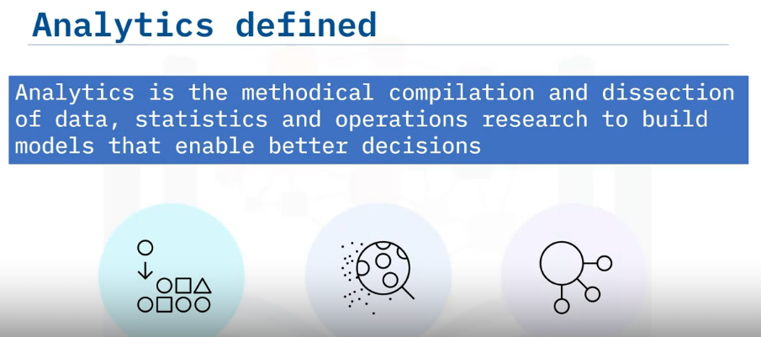
Introduction to Analytics and Business Intelligence (BI) Tools
Define analytics.
Describe how business intelligence tools have changed analytics processing and results.
Outline the purpose of Analytics and Business Intelligence tools.
Define what an Analytics or Business Intelligence tool is, and
Identify several Analytics and Business Intelligence tools

Slide 3
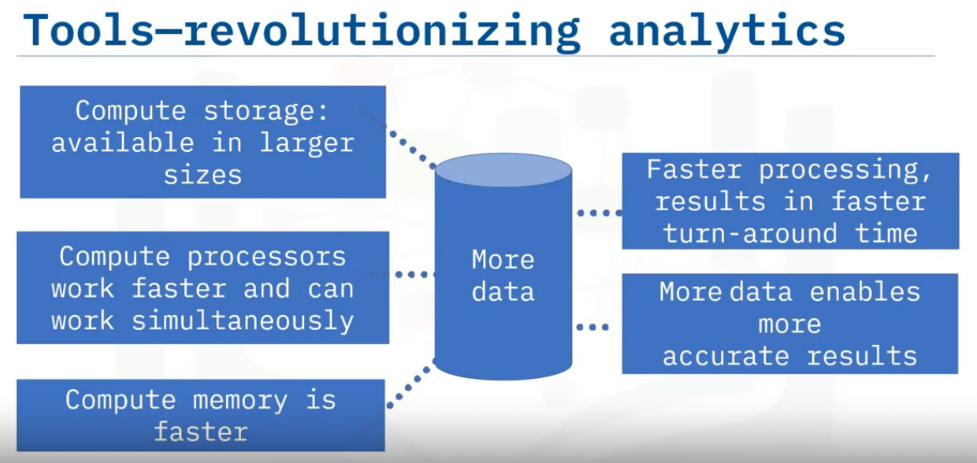
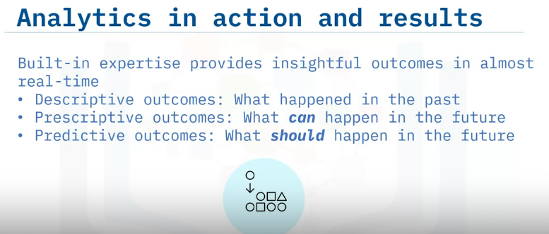
Compute storage, processors, and memory capabilities have significantly increased speed, capacity, and affordability.
The data warehousing solutions available now store large volumes of data with low latency.
These exponential increases in both capacity and speed for storage, processors, and memory enable organizations to now process petaflops of data with swift turnaround times.
When more data is available, analytics are more accurate
Organizations can use BI tools’ built-in expertise to analyze data and find patterns using machine learning based on statistical modeling.
Today’s analytical tools have reduced the time to churn data so much that results are now almost real-time.
These analytical outcomes can be descriptive, prescriptive, or predictive.
Descriptive analytics provide insight into the past. Predictive analytics provide insight into what could happen in the future.
In contrast, prescriptive analytics provide insight into what actions an organization should take to create a specific outcome in the future.

Slide 4
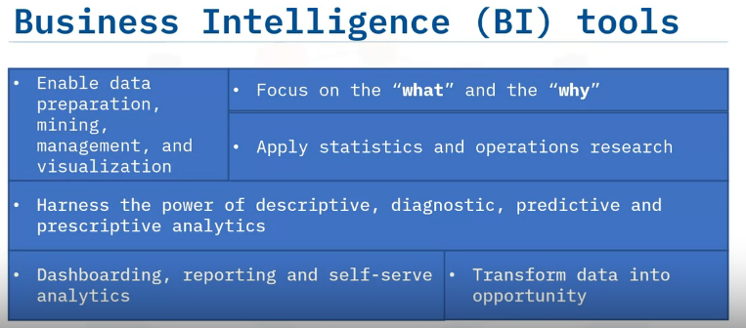
Business intelligence tools, or BI tools, enable data preparation, data mining, data management, and data visualization.
Implementing BI tools is much like solving a puzzle to gain a more comprehensive picture of your organization.
BI tools help organizations focus on the what and the why.
Businesses use their data to discover what is happening and determine what triggered a specific outcome.
BI tools, as highly evolved software, apply statistics and operations research as part of the process of creating inherent intelligence.
BI tools also help organizations harness the power of descriptive, diagnostic, predictive, and prescriptive analytics for operational and strategic decisions.
Users can analyze business operations through dashboarding, reporting, and self-serve analytics based on historical, current, and projected data to transform data into business opportunities

Slide 5
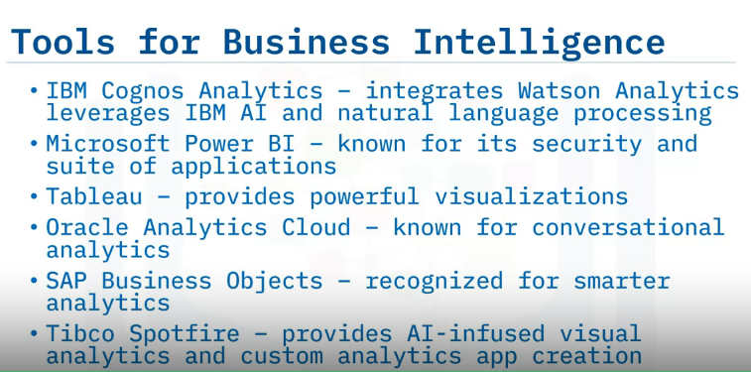
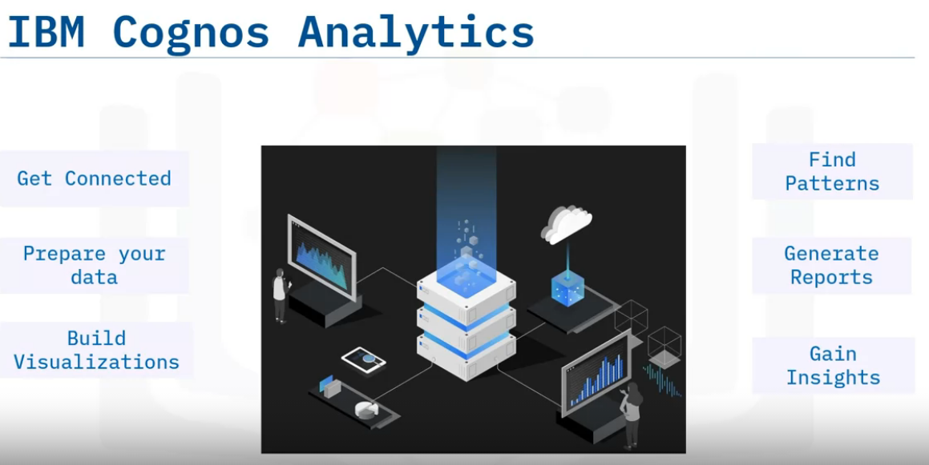
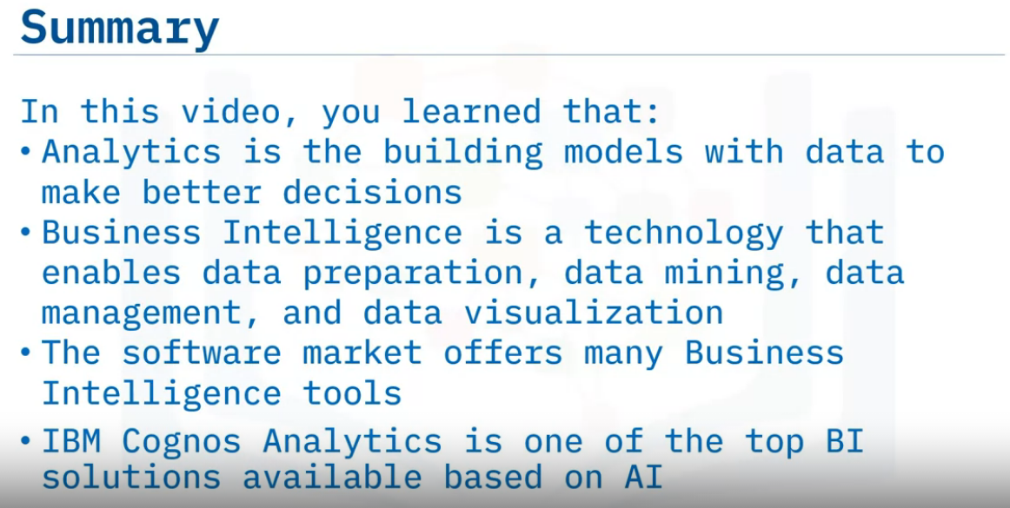
here are many solutions available in the market that empower organizations with the ability to perform advanced analytics.
Some of the well-known players in the market are, IBM Cognos Analytics, which integrates Watson Analytics that leverages IBM’s artificial intelligence and natural language processing,
Microsoft Power BI, well known for its secure insights,
Tableau is known for powerful visualizations,
Oracle Analytics cloud known for its conversational analytics,
SAP Business Objects known for its intelligent analytics, and
Tibco Spotfire offers scalability for small and large organizations.

Slide 6
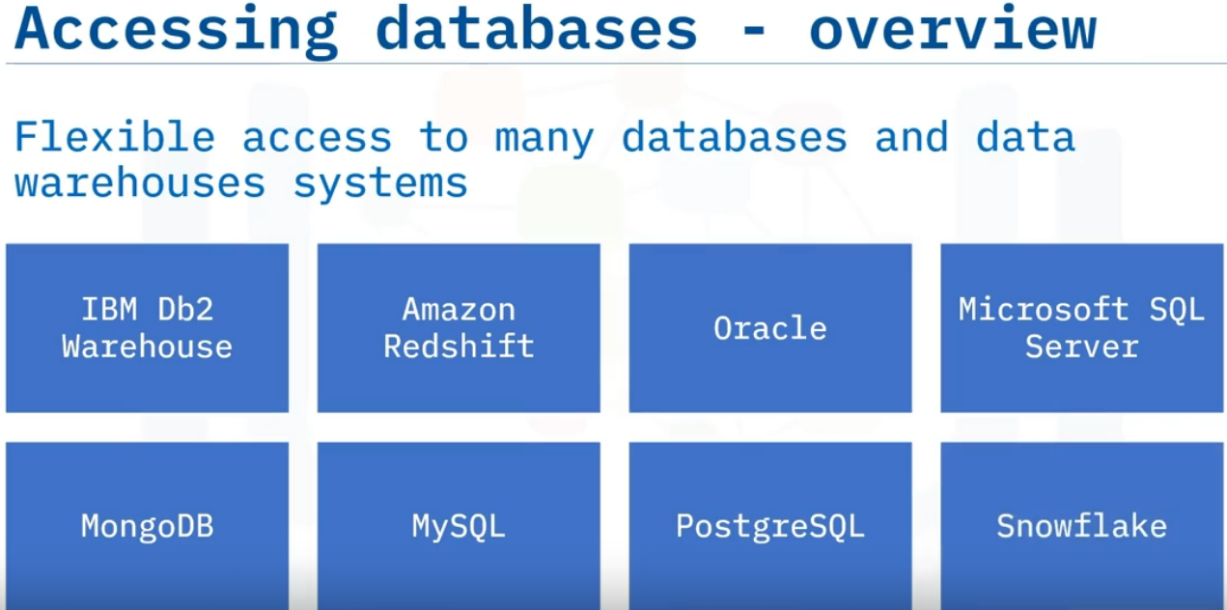
Accessing Your Warehouse With Cognos
Describe the steps involved in accessing a database or data warehouse from Cognos Analytics.
Create an interactive dashboard using data in the data warehouse, and
Add multiple visualizations to the dashboard.
In addition to files and static data sets, you can use Cognos Analytics to access a variety of databases and data warehouses both on the cloud and in your enterprise, including IBM Db2 Warehouse, Amazon Redshift, Oracle, Microsoft SQL Server, MongoDB, MySQL, PostgreSQL, Snowflake, and others.

Slide 7
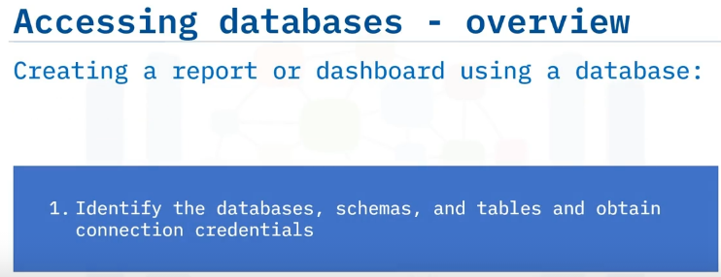



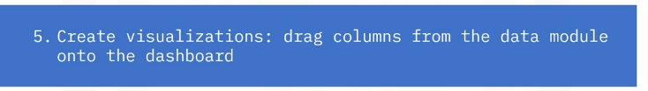
First, identify the source databases, including schemas and tables, and obtain their connection credentials.
Next, within Cognos Analytics, you'll create data server connections to the selected databases.
And then, for each connection, create data modules for the selected tables.
Next, create a dashboard and add the data modules as sources.
And then drag columns from the data module onto the dashboard canvas

Slide 8
For this demo, you will use an “IBM Db2 on Cloud” database as the source data warehouse.
First, you need to obtain the service credentials to connect to the database from the Db2 instance page by clicking "New Credential."
Now you need to name the service credential, set the role to Manager, and click Add to add the service credential. Scrolling down, you can see the service credential you just created displayed within the “Service credentials” list.
Click the credential drop-down arrow to view the credential's details.
Here's a snippet of the service credential details. Copy the username, password, and the JDBC URL.
You will need to replace the placeholder values for the username and password in the JDBC URL with actual values.
Remember to remove the angle brackets.

Slide 9
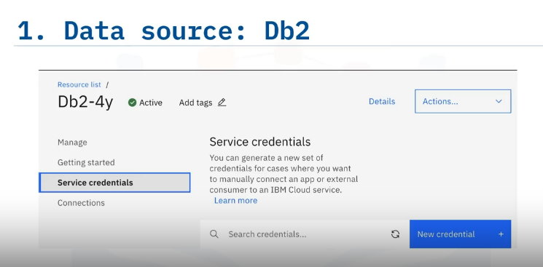
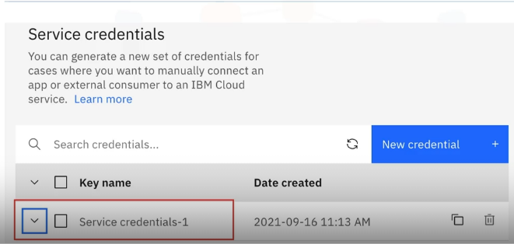
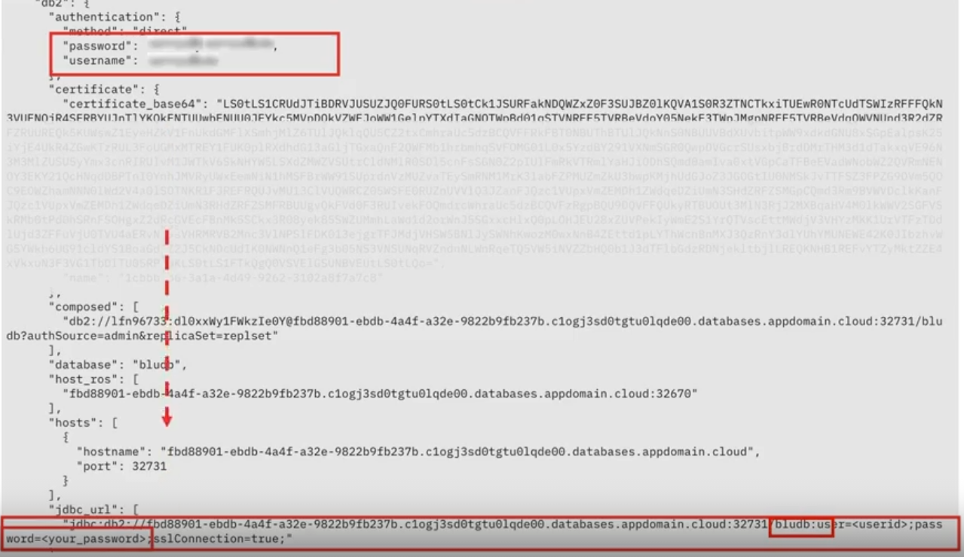
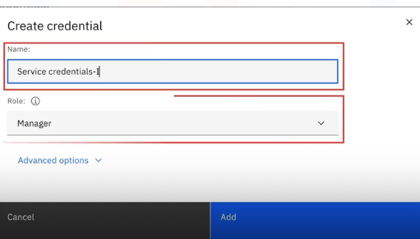

Slide 10
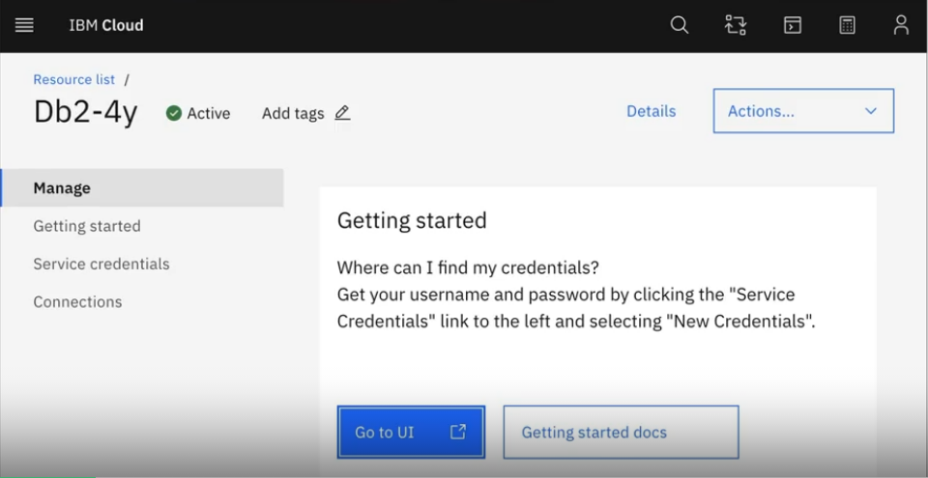
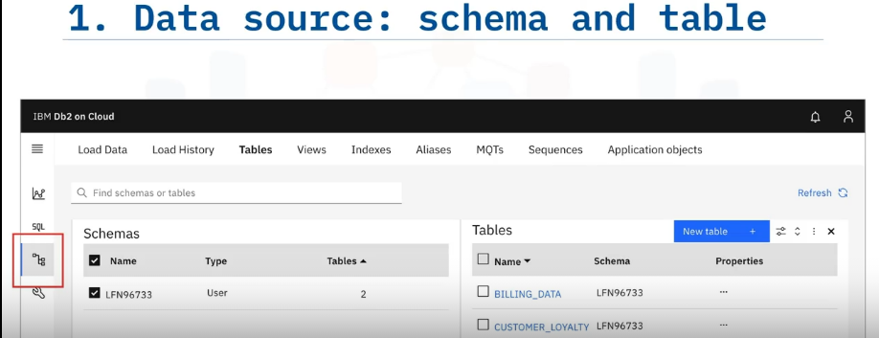
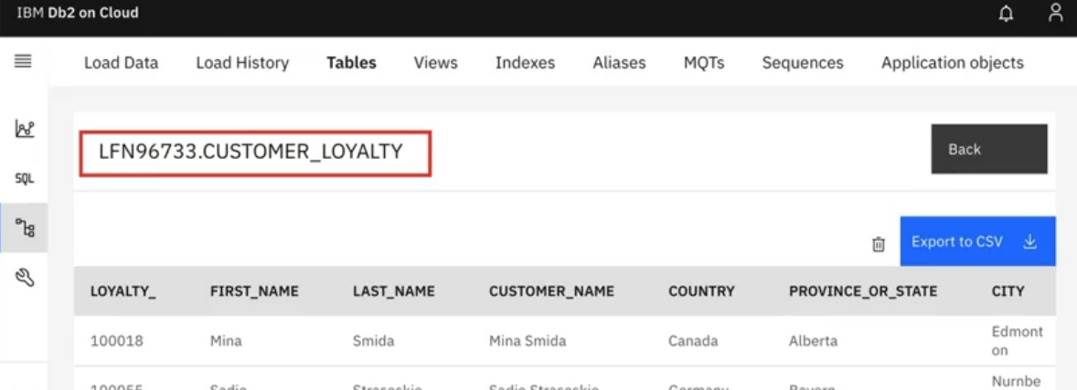
Next, let's identify and preview the data, that is, the schema and tables, that you need for the Cognos dashboard.
Under Manage, click Go to UI. This action opens the page where you can view, edit, and administer the Db2 instance.
Within the Db2 UI, click the data icon, select the schema, and select the table you want to use for your dashboard in Cognos Analytics.
Select the Customer Loyalty table.
Here, you are previewing the Customer Loyalty table in the LFN96733 schema.
Viewing your table provides ideas about the data attributes you can visualize.

Slide 11
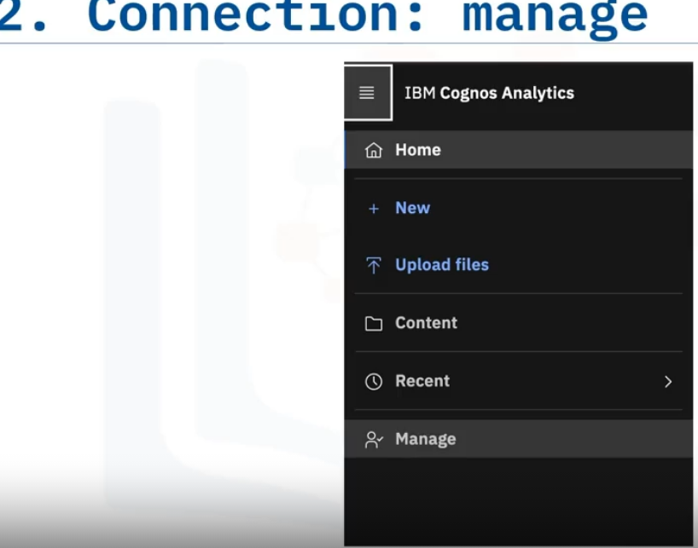
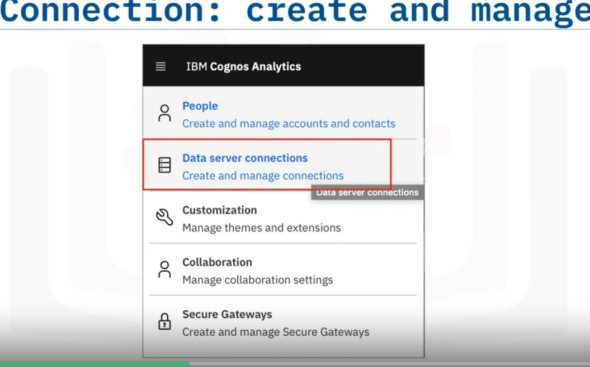
Now that you have the database credentials and identified the data you want to visualize, go to the Cognos Analytics web page, click the hamburger menu, and then Manage.
You'll see several management options, but your task is to click Data server connections to connect with a data server.
Click the plus icon to view the data warehouse options that you can connect to using Cognos.

Slide 12
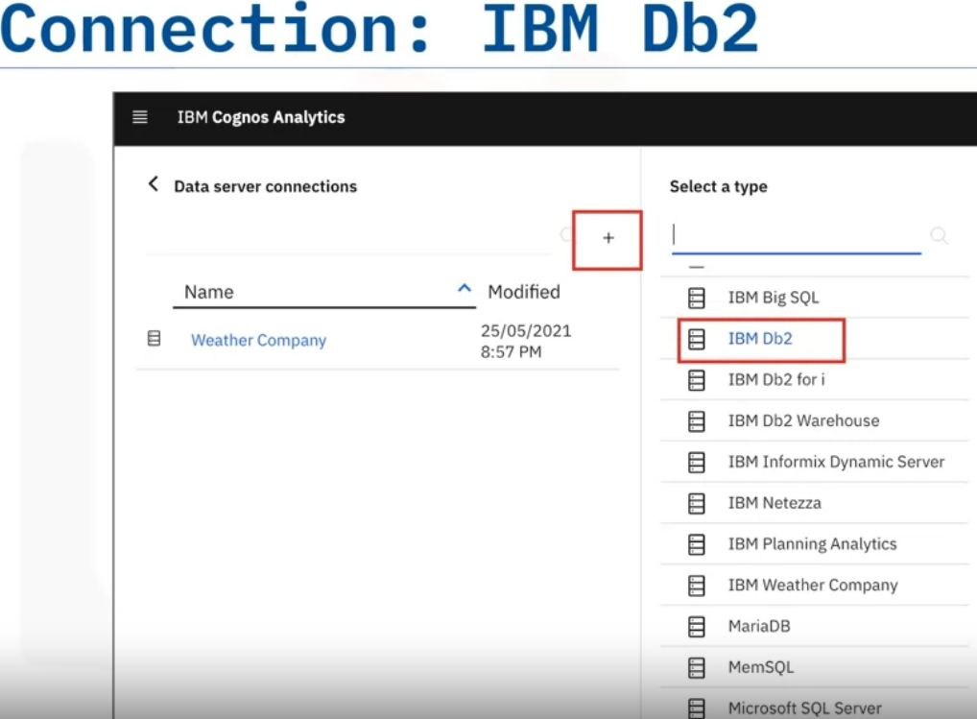
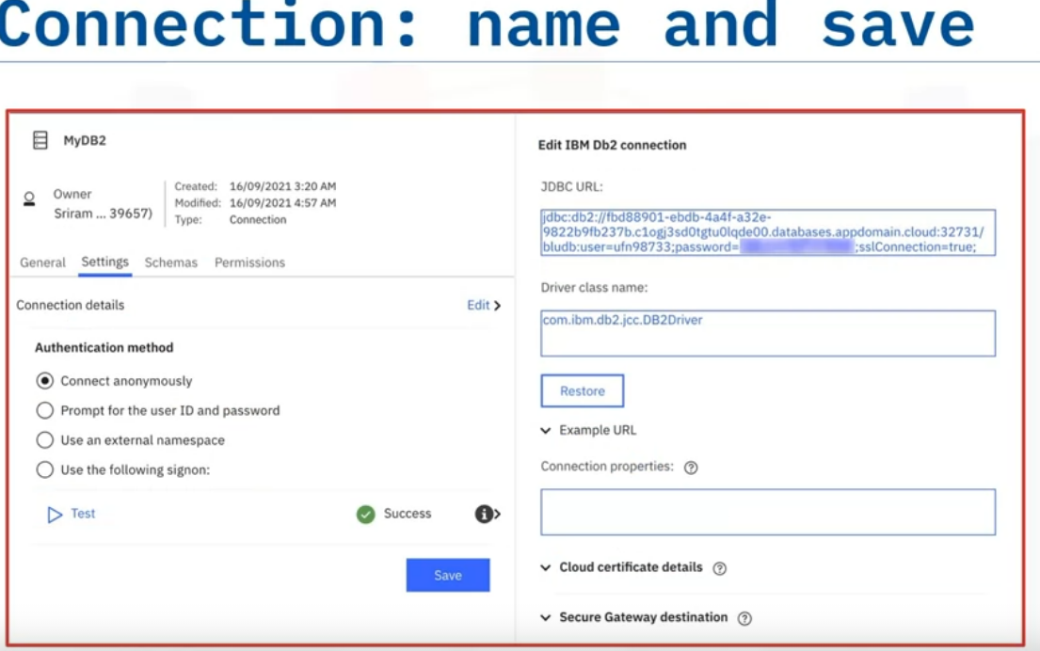
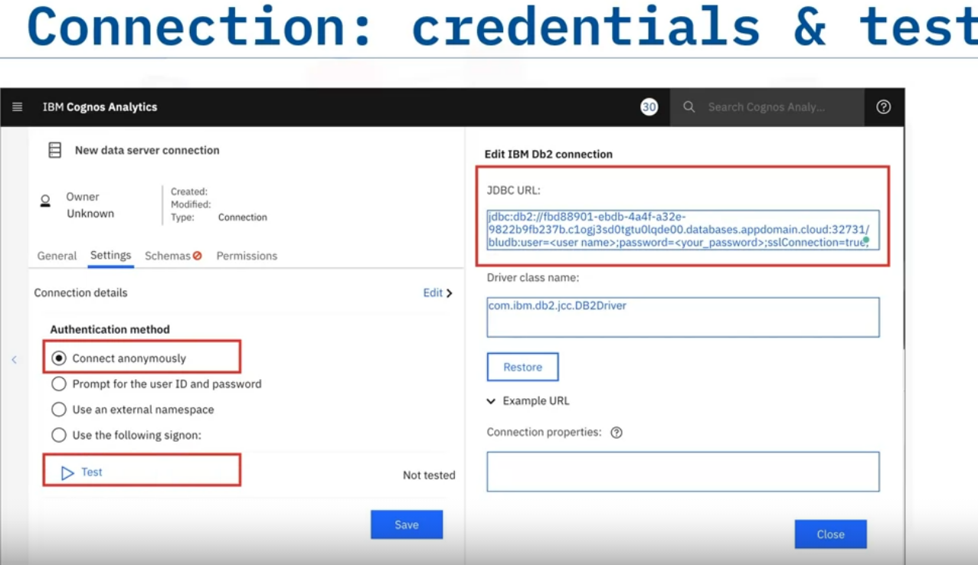
Next, click IBM Db2.
Click the option to connect anonymously and paste the JDBC connection string you copied from the Db2 instance administration page.
Replace the username and password with your Db2 service credentials.
Click Test to ensure you have a successful data connection
If the test was successful, you'll see Success with a green checkmark icon.
You can then name the connection. Here, the connection is named MyDB2. Click Save.

Slide 13
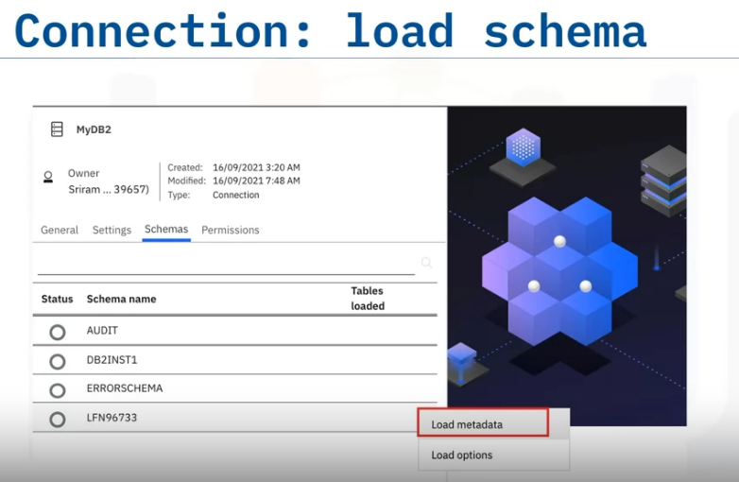
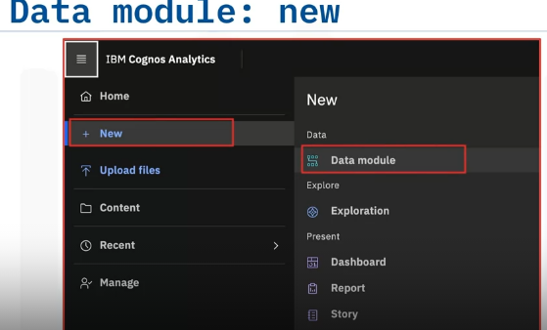
Next, you'll load the schema.
Go to the Schema tab and click the three dots next to the schema you want to load.
Then, click Load metadata. This action takes a few seconds while Cognos fetches and loads the metadata from the Db2 instance.
Once the metadata is loaded, you'll see a green checkmark next to the schema name.
Now that you have connected to the DB2 instance, you create a new data module that will link
to the source data. This action opens a page where you can select the data source.

Slide 14
To be continueed…Watch Video

Slide 16
